Slide 1
Binary Tree Traversals
Tree Traversal classification
BreadthFirst traversal
DepthFirst traversals: Pre-order, In-order, and Post-order
Reverse DepthFirst traversals
Invoking BinaryTree class Traversal Methods
accept method of BinaryTree class
BinaryTree Iterator
Using a BinaryTree Iterator
Expression Trees
Traversing Expression Trees

Slide 2
Tree Traversal Classification
The process of systematically visiting all the nodes in a tree and performing some processing at each node in the tree is called a tree traversal.
A traversal starts at the root of the tree and visits every node in the tree exactly once.
There are two common methods in which to traverse a tree:
  Breadth-First Traversal (or Level-order Traversal).
  Depth-First Traversal:
      Preorder traversal
      Inorder traversal (for binary trees only)
      Postorder traversal

Slide 3
Breadth-First Traversal
Let queue be empty;
if(tree is not empty)
queue.enqueue(tree);
while(queue is not empty){
tree = queue.dequeue();
visit(tree root node);
if(tree.leftChild is not empty)
enqueue(tree.leftChild);
if(tree.rightChild is not empty)
enqueue(tree.rightChild);
}
Note:
When a tree is enqueued it is the address of the root node of that tree that is enqueued
visit means to process the data in the node in some way

Slide 4
Breadth-First Traversal (Contd.)
The BinaryTree class breadthFirstTraversal method:
public void breadthFirstTraversal(Visitor visitor){
QueueAsLinkedList queue = new QueueAsLinkedList();
if(!isEmpty()) // if the tree is not empty
queue.enqueue(this);
while(!queue.isEmpty() && !visitor.isDone()){
BinaryTree tree = (BinaryTree)queue.dequeue();
visitor.visit(tree.getKey());
if (!tree.getLeft().isEmpty())
queue.enqueue(tree.getLeft());
if (!tree.getRight().isEmpty())
queue.enqueue(tree.getRight());
}
}

Slide 5
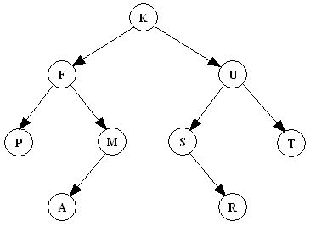
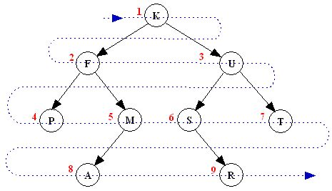
Breadth-First Traversal (Contd.)
Breadth-First traversal visits a tree level-wise from top to bottom
K F U P M S T A R

Slide 6
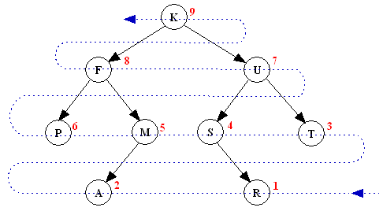
Breadth-First Traversal (Contd.)
Exercise: Write a BinaryTree instance method for Reverse Breadth-First Traversal
R A T S M P U F K

Slide 7
Depth-First Traversals
Name | for each Node: | CODE
Preorder (N-L-R) | Visit the node Visit the left subtree, if any. Visit the right subtree, if any. | public void preorderTraversal(Visitor v){ if(!isEmpty() && ! v.isDone()){ v.visit(getKey()); getLeft().preorderTraversal(v); getRight().preorderTraversal(v); } }
Inorder (L-N-R) | Visit the left subtree, if any. Visit the node Visit the right subtree, if any. | public void inorderTraversal(Visitor v){ if(!isEmpty() && ! v.isDone()){ getLeft().inorderTraversal(v); v.visit(getKey()); getRight().inorderTraversal(v); } }
Postorder (L-R-N) | Visit the left subtree, if any. Visit the right subtree, if any. Visit the node | public void postorderTraversal(Visitor v){ if(!isEmpty() && ! v.isDone()){ getLeft().postorderTraversal(v) ; getRight().postorderTraversal(v); v.visit(getKey()); } }

Slide 8
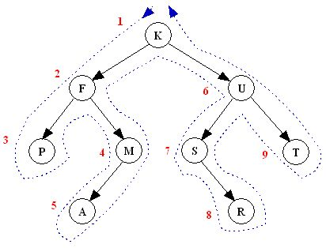
Preorder Depth-first Traversal
N-L-R
“A node is visited when passing on its left in the visit path”
K F P M A U S R T

Slide 9
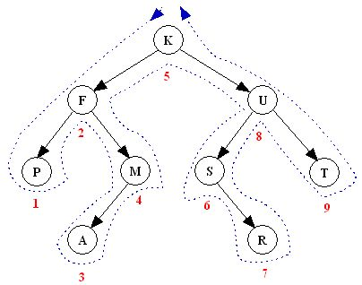
Inorder Depth-first Traversal
L-N-R
“A node is visited when passing below it in the visit path”
Note: An inorder traversal can pass through a node without visiting it at
that moment.
P F A M K S R U T

Slide 10
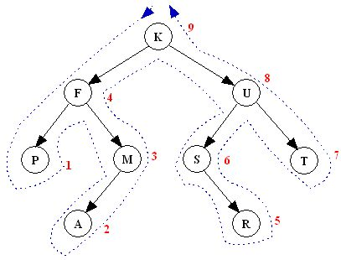
Postorder Depth-first Traversal
L-R-N
“A node is visited when passing on its right in the visit path”
Note: An postorder traversal can pass through a node without visiting it at that moment.
P A M F R S T U K

Slide 11
Reverse Depth-First Traversals
There are 6 different depth-first traversals:
  NLR (pre-order traversal)
  NRL (reverse pre-order traversal)
  LNR (in-order traversal)
  RNL (reverse in-order traversal)
  LRN (post-order traversal)
  RLN (reverse post-order traversal)
The reverse traversals are not common
Exercise: Perform each of the reverse depth-first traversals on the tree:

Slide 12
Invoking BinaryTree Traversal Methods
The following code illustrates how to display the contents of
a BinaryTree instance using each traversal method:
Visitor v = new PrintingVisitor() ;
BinaryTree t = new BinaryTree() ;
// . . .Initialize t
t.breadthFirstTraversal(v) ;
t.postorderTraversal(v) ;
t.inorderTraversal(v) ;
t.postorderTraversal(v) ;

Slide 13
The accept method of the BinaryTree class
Usually the accept method of a container is allowed to visit the elements of the container in any order.
A depth-first tree traversal visits the nodes in either preoder or postorder and for Binary trees inorder traversal is also possible.
The BinaryTree class accept method does a preorder traversal:
public void accept(Visitor visitor)
{
preorderTraversal(visitor) ;
}

Slide 14
BinaryTree class Iterator
The BinaryTree class provides a tree iterator that does a preorder traversal.
The iterator is implemented as an inner class:
private class BinaryTreeIterator implements Iterator{
Stack stack;
public BinaryTreeIterator(){
stack = new StackAsLinkedList();
if(!isEmpty())
stack.push(BinaryTree.this);
}
public boolean hasNext(){
return !stack.isEmpty();
}
public Object next(){
if(stack.isEmpty())throw new NoSuchElementException();
BinaryTree tree = (BinaryTree)stack.pop();
if (!tree.getRight().isEmpty()) stack.push(tree.getRight());
if (!tree.getLeft().isEmpty()) stack.push(tree.getLeft());
return tree.getKey();
}
}

Slide 15
Using BinaryTree class Iterator
The iterator() method of the BinaryTree class returns a new instance of the BinaryTreeIterator inner class each time it is called:
The following program fragment shows how to use a tree iterator:
public Iterator iterator(){
return new BinaryTreeIterator();
}
BinaryTree tree = new BinaryTree();
// . . .Initialize tree
Iterator i = tree.iterator();
while(i.hasNext(){
Object obj = e.next() ;
System.out.print(obj + " ");
}

Slide 16
Expression Trees
An arithmetic expression or a logic proposition can be represented by a Binary tree:
  Internal vertices represent operators
  Leaves represent operands
  Subtrees are subexpressions
A Binary tree representing an expression is called an expression tree.
Build the expression tree bottom-up:
  Construct smaller subtrees
  Combine the smaller subtrees to form larger subtrees

Slide 17
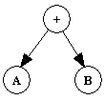
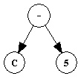
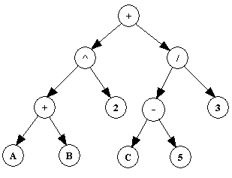
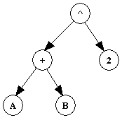
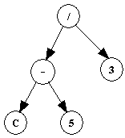
Expression Trees (Contd.)
Example: Create the expression tree of (A + B)² + (C - 5) / 3

Slide 18
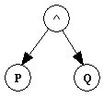
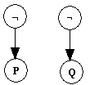
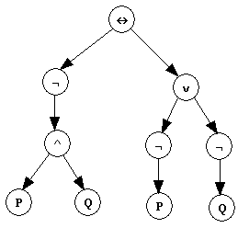
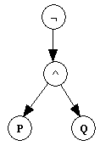
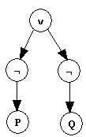
Expression Trees (Contd.)
Example: Create the expression tree of the compound proposition: ¬(p ∧ q) ↔ (¬p ∨ ¬q)

Slide 19
Traversing Expression Trees
An inorder traversal of an expression tree produces the original expression (without parentheses), in infix order
A preorder traversal produces a prefix expression
A postorder traversal produces a postfix expression
Infix: A + B ^ 2 + C – 5 / 3
Prefix: + ^ + A B 2 / - C 5 3
Postfix: A B + 2 ^ C 5 - 3 / +

